Slide 1
Expert Systems

Slide 2
Expert system solve problems normally solved by human experts
These are highly domain specific
To solve expert level problems, expert system need
Access to substantial knowledge base
Use of one or more reasoning mechanisms
Mechanism for explanation

Slide 3
Architecture of expert system
User
User interface
Facts,queries
Advice,consultation,justificaton
Knowledge base
Inference engine

Slide 4
User interface
Allows user to enter rules and facts about a particular situation and ask questions to the system.
Provide responses to user requests.
Supports all other communication between system and user.
Knowledge base
Developed by experts in the area.
Data in the form of rules.
Is updated regularly so that system provides most relevant and complete assistance to the user – knowledge acquisition module.
Inference Engine
Uses rules provided by Knowledge base and the user to infer new facts.

Slide 5
Representing and Using Domain Knowledge
Most widely used way for representing knowledge is a Set of production rules of the form if-then, which is often coupled with a frame system that defines the object that occur in the rules
Reasoning with the Knowledge
Expert System represent knowledge in a rule format. Hence also known as Rule-Based Expert System.
Some reasoning mechanisms:
Forward chaining (R1)
backward chaining(MYCIN)
justification-based truth maintenance system(DESIGN ADVISOR ).

Slide 6
MYCIN
Developed by Edward Shortliffe,Bruce G Buchanan and Stanley N Cohen in LISP
Its an early expert system to identify bacteria causing severe infections and to recommend antibiotics, with dosage adjusted for patient’s body weight.
MYCIN attempts to recommend appropriate therapies for patients with bacterial infections.
It is never used in practice,but has an acceptance in 69% of cases
It interacts with physician to acquire clinical data it needs
MYCIN represents most of its diagnostic knowledge as a set of rules.
Rule has a certainty factor associated with it, which is a measure of the extent to which the evidence that is described by the antecedent of the rule supports the conclusion that is given in the rule’s consequent.
Certainty factor has a value between 0 and 1.

Slide 7
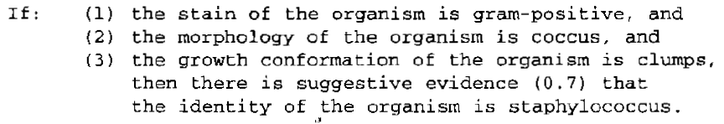
MYCIN use rules to reason backward to clinical data available to find the disease causing organism and then it attempts to select therapy to treat the disease
A typical MYCIN rule looks like:

Slide 8
R1 or XCON
R1(XCON or eXpert CONfigurer ) is written in OPS5 by john Mcdermott
It is used in design domain
Used to select the computer system components based on the customer's requirements.
It assist in the ordering of DEC’s VAX computer systems by automatically selecting the computer system components based on customer requirements.
It has an accuracy of 95-98%
Before XCON, every cable, connection had to be ordered separately. The sales people were not always very technically expert, so customers would find that components were often didnt match. XCON interact with the sales person, asking critical questions and prepare a coherent and workable system specification/order slip.

Slide 9
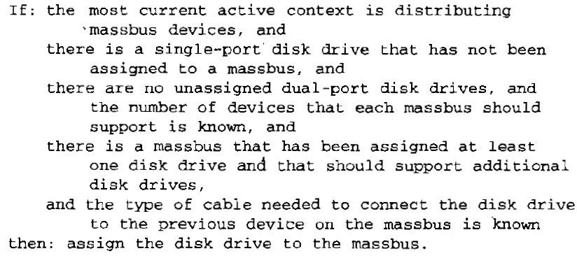
Unlike MYCIN, there is no measure of certainty in rules of RI
In R1’s domain it is possible to state exactly what it has to do for each situation.
Good human expertise is involved in this area
As it is design task alternatives need not be considered
A typical R1 rule looks like:

Slide 10
PROSPECTOR
It is developed by P E Hart and R O Duda in LISP
It provides advice on mineral exploration.It provide active consultation on problems of mineral exploration and resource evaluation
Here, each rule contains two confidence estimates.
The first estimate indicates the extent to which the presence of evidence described in the condition part of rule suggests the validity of rule’s conclusion.
The second estimate indicates the extent to which the lack of evidence indicates that the conclusion is not valid.

Slide 11

Its rule looks like

Slide 12
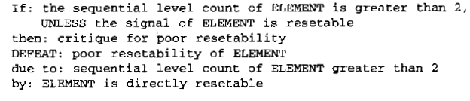
DESIGN ADVISOR
Developed by robin L Steele, Scott A Richardson and Michel A winchell
Its an expert system that critics chip designs. It give advice to chip designer, who can accept or reject the advice
If designer rejects an advice ,system can use aa justification-based truth maintenance to revise its model of circuit
Its rule looks like

Slide 13
Expert system shells
Expert System is usually built from scratch in LISP.But several systems has a lot of common things.
Most systems have a set of rules combined with interpreter
It is possible to separate interpreter from domain specific knowledge. The resulting interpreter is called shell
New expert system can be built by adding new knowledge corresponding to problem domain
A single expert system shell can be used to build a number of different expert systems.
Expert system shells must provide mechanisms for knowledge representation, reasoning, explanation and knowledge acquisition
Shells must be easy to integrate and must provide easy to use interface

Slide 14
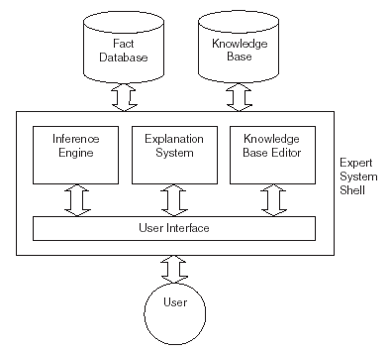

Slide 15
Knowledge base: database of rules (domain knowledge).
Explanation system: explains the decisions the system makes.
Knowledge base editor: allows the user to edit the information in the knowledge base.
User Interface: the means by which the user interacts with the expert system.

Slide 16
EMYCIN or Empty MYCIN or Essential MYCIN is a shell derived from MYCIN
Its a domain-independent version of MYCIN that contains all of MYCIN except its knowledge.
EMYCIN facilitated the development of other expert systems, such as PUFF, an application for the diagnosis of pulmonary problems.

Slide 17
Explanation
In order for an expert system to be an effective tool, people must be able to interact with it easily.
To facilitate this interaction, expert system should have the following two capabilities in addition to its underlying task:
1.Explain its reasoning :
People will not accept results unless they are convinced of the accuracy of the reasoning process that produced the results.
Reasoning process must proceed in understandable way and enough meta knowledge must be available to generate explanations
2. Acquire new knowledge and modifications of old knowledge:
Expert systems derive their power from the richness of the knowledge bases they exploit. Hence it should be complete and accurate.
One way to get the knowledge is through interaction with human expert, another way is to have program learn expert behavior from raw data.

Slide 18
TEIRESIAS was the first program to support explanation and knowledge acquisition.
It is developed by Randall Davis and is written in INTERLISP
TEIRESIAS served as the front end for the MYCIN expert system.
Program asks for information to continue reasoning. doctor wants to know why the pgm wants that information and later asks how the pgm arrived at a conclusion that it claimed
Questions were answered using goal tree and backward reasoning
The production system model is very general. So, it fails to provide all explanations that a human wants. TEIRESIAS-MYCIN just answers questions “why” and “how”.
A fragment of a TEIRESIAS-MYCIN conversation with a user (a doctor) is shown below:

Slide 19
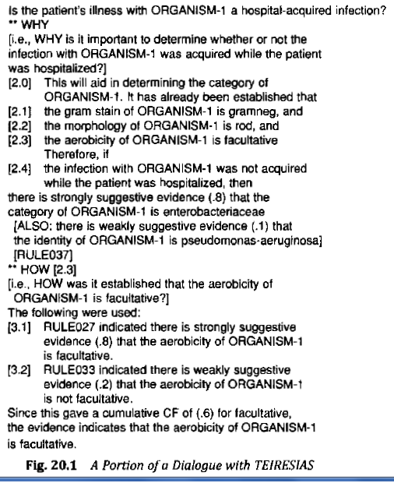

Slide 20
SALT is a knowledge acquisition pgm developed by Sandra Marcus and John McDermott
It is used to built expert systems that design artifacts ans consturct schedule through ‘propose and revise strategy’
SALT is capable of answering additional questions like “why-not” and “what-if”
A human might ask such questions to locate incorrect or missing knowledge in system

Slide 21
Knowledge acquisition
In building expert systems,a knowledge engineer collect expert knowledge and it is translated into rules.,then it is iteratively refined
There are many programs that interact with domain experts to extract expert knowledge efficiently.
Knowledge acquisition is more useful in particular domains
These programs provide support for the following activities:
Entering knowledge.
Maintaining knowledge base consistency.
Ensuring knowledge base completeness.
There are two ways to get domain knowledge
One way to get the knowledge is through interaction with human expert.
To have program learn expert behavior from raw data.

Slide 22
MOLE
Knowledge acquisition tool developed by Larry J Eshelman and John McDermott
It’s a system for heuristic classification problem, such as diagnosing diseases
An expert system produced by MOLE accepts input data, comes up with a set of explanations or classifications that cover(or explain) the data, then uses differentiating knowledge to determine which one is the best. The process is iterative.
MOLE interacts with a domain expert to produce a knowledge base that a system called MOLE-performance uses to solve problems.

Slide 23
The acquisition proceeds through several steps:
Initial Knowledge base construction: MOLE asks the expert to list common experts or complaints that might require diagnosis. For each symptom MOLE prompts for a list of possible explanations. It keeps on seeking higher level explanation until comes up with a set of ultimate causes.
Refinement of the knowledge base: MOLE tries to identify the weakness of the knowledge base. One approach is to find holes and prompt the expert to fill them. It is difficult to know whether a knowledge base is complete, so MOLE lets expert watch MOLE-p solving problems. Whenever MOLE-p makes a wrong diagnosis, the expert adds new knowledge

Slide 24
SALT
SALT is a knowledge acquisition pgm developed by Sandra Marcus and John McDermott
It is used to built expert systems that design artifacts ans consturct schedule through ‘propose and revise strategy’
The system first proposes an extension to the current design. Then it checks whether the extension violates any global or local constraints. Constraint violations are fixed and the process repeats.
Domain experts must list overall design constraints, but they need not be so good at explaining how to arrive at global solutions.
An expert can watch problem solving system and can override system’s decision

Slide 25
SALT builds a dependency network as it converses with the expert.
Each node represents a parameter whose value must be acquired or generated.
There are 3 kinds of links
Contributes to (generate value for parameters)
Constraints (rules out certain value for parameters )
Suggests revision of ( fix constraint violation)

Slide 26
META DENDRAL
First program to use learning techniques to construct rules for an expert system automatically.
It build rules to be used by DENDRAL ,whose job was to determine the structure of complex chemical compounds.
DENDRAL help organic chemists in identifying unknown organic molecules, by analyzing their mass spectra and using knowledge of chemistry.
META DENDRAL was able to induce its rules based on a set of mass spectrometry data, it was then able to identify molecular structures with very high accuracy.
META DENDRAL uses Version space algorithm

